Slide 1
ShopEasy Market Analysis Summary

Slide 2
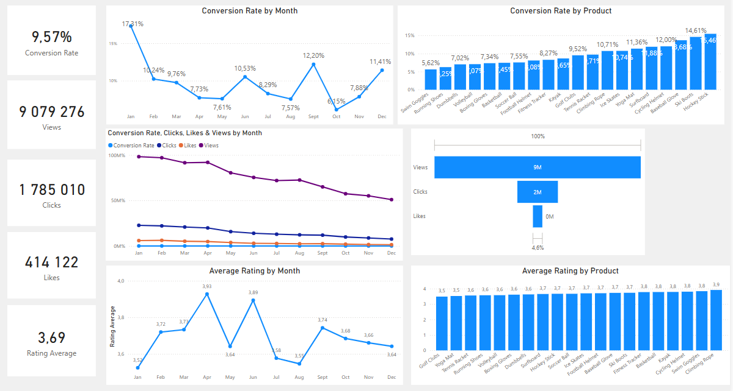
Overview
Decreased Conversion rates: After dropping to 5,0% in October , the conversion rate rebounded strongly to 10,2% in December.
Customer Feedback Analysis:
  Customer ratings have remained consistent, with an average of 3,7 throughout the year.
  Even though the average rating is stable, it is still below the target of 4,0 which suggests that there needs to be an improvement focused on customer satisfaction.
Reduced Customer Engagement:
  There is a decrease in overall social media engagement, with views dropping throughout the whole year.
  Even though the clicks and likes are low compared to view, the click-through rate stands at 15.7% , implying that engaged users are still interacting effectively.

Slide 3
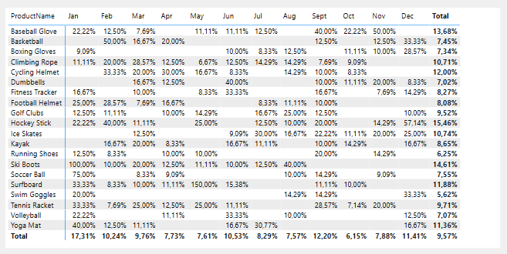
Decreased Conversion Rates
General Conversion Trend:
  Throughout the year, there were variations in the conversion rates, with higher numbers of products converting successfully in months such as February and July. This suggests that while some products has strong seasonal peaks, there is potential to improve conversions in lower-performing months through targeted interventions
Lowest Conversion Month:
  May experienced the lowest overall conversion rate at 4,3% with no products standing out significantly in terms of conversion,. This indicates a potential need to revisit marketing strategies or promotions during this period to boost performance.
Highest Conversion Rates:
  January recorded the highest overall conversion rates at 18,5%, driven significantly by the Ski Boots with a remarkable 150% conversion. This indicates a strong start to the year., likely fuelled by seasonal demand and effective marketing strategies.

Slide 4
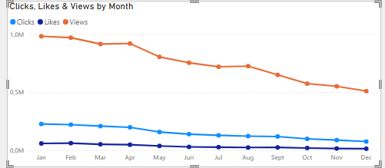
Reduced Customer Engagement
Declining Views:
  Views Peaked in February and July but declined from August onwards, this indicates that the audience engagement has reduced in the later half of the year.
Low Interaction Rates:
  Clicks and likes remained consistently low compared to views, suggesting the need for more engaging content or stronger calls to action
Content Type Performance:
  Blog content drove the most views, especially in April and July, while social media and video content maintained steady but slightly lower enagegement

Slide 5
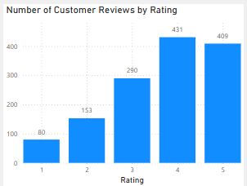
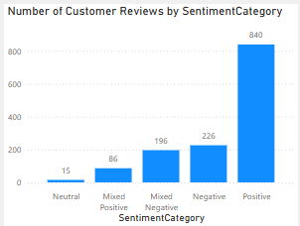
Customer Feedback Analysis
Customer Rating Distribution:
  The majority of customer reviews are in the higher ratings, with 140 reviews at 4 stars and 135 reviews at 5 stars, suggesting an overall positive feedback. Lower ratings (1-2 stars) account for a smaller proportion, with 26 review at 1 star and 57 reviews at 2 stars.
Sentiment Analysis:
  Positive sentiment dominates with 257 reviews, reflecting a generally satisfied customer base. Negative sentiment is present in 82 reviews, with a smaller number of mixed and neutral sentiments.
Opportunity for improvement:
  The presence of mixed positive and mixed negative sentiments suggests that there are opportunities to convert those mixed experiences into more clearly positive ones, potentially boosting overall ratings. Addressing the specific concerns in mixed reviews could elevate customer satisfaction.

Slide 6
Goals and Action
Goals
Increase Conversion Rates:
  Goal: Identify factors impacting the conversion rate & provide recommendations to improve it.
  Insight: Highlight key stages where visitors drop off & suggest improvements to optimise the conversion funnel.
Enhance Customer Engagement:
  Goal: Determine which types of content drive the highest engagement.
  Insight: Analyse interaction levels with different types of marketing content to inform better content strategies
Improve Customer Feedback Scores:
  Goal: Understand common themes in customer reviews & provide actionable insights.
  Insight: Identify recurring positive & negative feedback to guide product & service improvements.
Actions
Increase Conversion Rates:
  Target High Performing Product Categories: Focus marketing efforts on products with demonstrated high conversion rates, such as Kayaks, Ski Boots, & Baseball Gloves. Implement seasonal promotions or personalised campaigns during peak months (e.g. Jan & September) to capitalise on these trends.
Enhance Customer Engagement:
  Revatilise Content Strategy: To turn around declining views & low interaction rates, experiment with more engaging content formats, such as interactive videos or user generated content. Additionally, boost engagement by optimising call-to-action placement in social media & blog content , particularly during historically lower-engagement months (September - December
Improve Customer Feedback Scores:
  Address Mixed & Negative Feedback: Implement a feedback loop where mixed & negative reviews are analysed to identity common issues. Develop improvement plans to address these concerns. Consider following up with dissatisfied customers to resolve issues & encourage re-rating, aiming to move average ratings closer to the 4,0 target.

